Slide 1


Team “Japhette Orchid”
Javascript Basics Team Project
By:
Христо Петров
Ивелин Кирилов
Асен Жечев
Димитър Стоянов

Slide 2
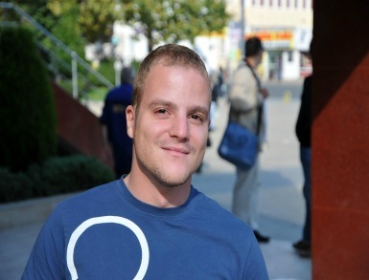


Team members
Христо Петров
Game Logic
Collision Detection
Ивелин Кирилов
Level Generation
AJAX File Reader
Асен Жечев
Game Design
Graphics
Димитър Стоянов
Game Logic
Collision Detection

Slide 3
Project task
Design and implement a client-side JavaScript game
Team “Japhette Orchid” project name:
“Alphabounce”
http://hpetrovit.com/webproject/alphabounce/

Slide 4
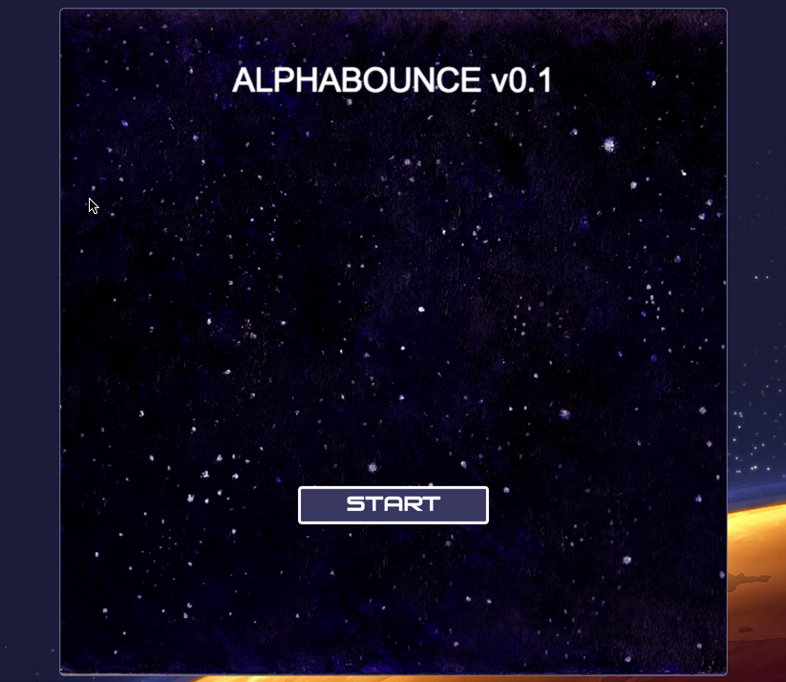
Game preview

Slide 5
result
Simple to play
Addictive gameplay
Lots of PowerUps and bonuses
Nice graphics

Slide 6
Tools and resources
Languages: HTML5, CSS, JavaScript
IDEs: Visual Studio, WebStorm
Version control tool: GitHub
Saviors: Google, Red Bull

Slide 7
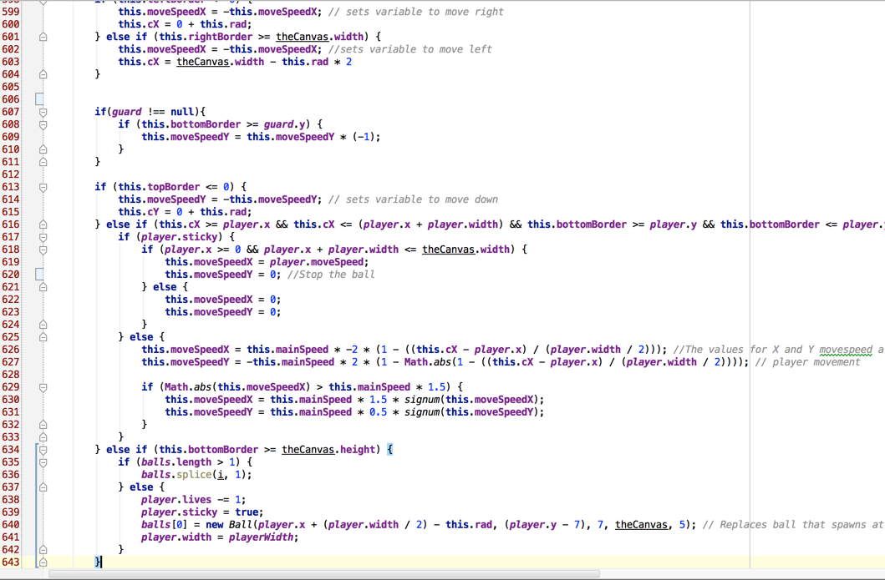
Source preview

Slide 8
Thanks for your attention

